Slide 1

GRIP- THE SPARKS FOUNDATION

Slide 2
DATA SCIENCE AND BUSINESS ANALYTICS
TASK 3- EXPLORATORY DATA ANALYSIS- RETAIL (LEVEL- BEGINNER) ON “SampleSuperstore” DATASET
BY- KEYA SENGUPTA
DATASET LINK: https://bit.ly/3i4rbWl

Slide 3
ABOUT THE SAMPLESUPERSTORE DATASET
SAMPLESUPERSTORE dataset is a kind of simulation which designs the extensive data analysis for delivering useful insights on how the company can increase its profits by minimising the losses as well as to improve the marketing and sales strategy. This includes data for sales of the product, categories, sub-categories, ship modes, segments, regions and as well as the profit for the product amongst the customer around the city and states of United States. This dataset consists of 9995 rows and 13 columns.
COMPLETE PROBLEM STATEMENT
SAMPLESUPERSTORE dataset gathers all information for analysing the profit as well as sales based on the location. It actually wants to extend its service by analysing the profit into weak areas that is how to improve sales and profit into those weak areas by the investors.

Slide 4
OBJECTIVES
The followings are main objectives:
To find out the region wise total profit as well as sales data and analysing the giving amount of discount for a particular ship modes, segments and categories in this data.
To find out category wise total profit for a particular ship modes, segments and regions by using percentage contribution.
To find out top 5 states whose profits are highest and analysing quantities for the given regions, ship modes, segments and categories.
To find out bottom 5 states whose profits are lowest and analysing quantities for the given regions, ship modes, segments and categories.
To find out top 5 cities whose profits are highest and analysing sales and discounts for the given regions, ship modes, segments and categories.
To find out bottom 5 cities whose profits are lowest and analysing sales and discounts for the given regions, ship modes, segments and categories.
To analyse profit and sales by using ship modes for the given regions, segments and categories.
To analyse profit region wise and as well as segment wise by using given fields.
To analyse profit subcategory wise by using categories.

Slide 5
Let’s explore and analyse the data…

Slide 7
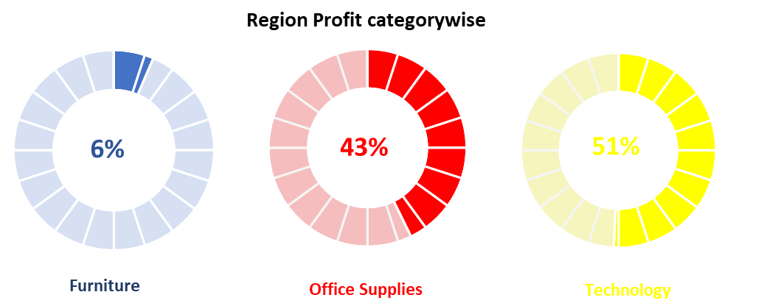
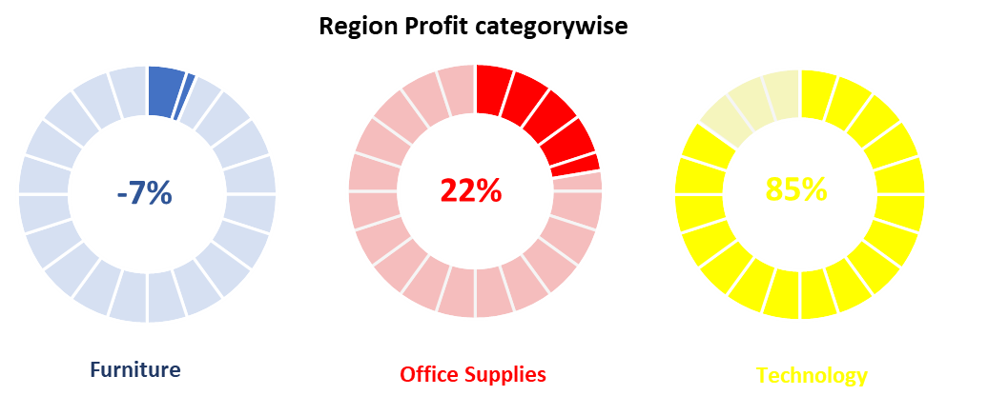
KEY INSIGHTS
Percentage contribution shows that technology
gives greater share of profit and furniture gives lesser share of profit given all regions and categories. But in case of central region, profit of furniture is negative i.e. (-7%).
Given ship modes and segments, second class gives more profit on office supplies but other class gives more profit on technology and in all segment technology contributes more profit.
But unfortunately in all cases profits of furniture is lesser.

Slide 8
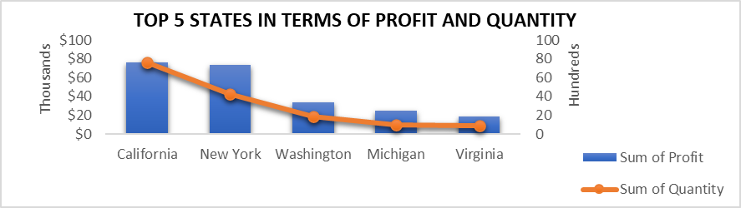
Now this figure clearly states that California has higher profit and higher quantity sold given by all field. After exploring the data, it shows-
Michigan gives higher profit in Central region.
New York gives higher profit in East region and also for first class and same day ship mode and for consumer and home office segment also.
Virginia gives higher profit in South region.
California gives higher profit in West region which is highest over all regions and also for second class and standard class ship mode and for corporate segment but engages higher quantity sold for first class and same day ship mode and also for consumer and home office segment not higher profit.
But all over California is top profit gainer which is very much attractive.

Slide 9
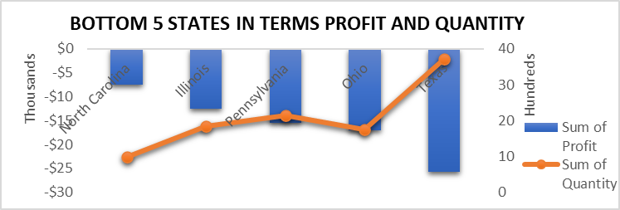
Now this figure clearly states that over all Texas has highest negative profit and North Carolina has highest negative quantity sold given by all field. After exploring the data, it shows-
Texas gives negative profit but gives higher quantity sold in Central region and first class, standard and second class ship mode and consumer segment also.
Ohio gives negative profit in East region as well as for first class ship mode and for technology category but Pennsylvania shows higher amount of quantity sold in East region as well as for second day ship mode and corporate segment.
North Carolina gives negative profit in South region as well as for same day ship mode but Florida is showing higher quantity sold amount.
Colorado gives negative profit in west region and also for home office segment also and Arizona is giving higher quantity sold amount.

Slide 10
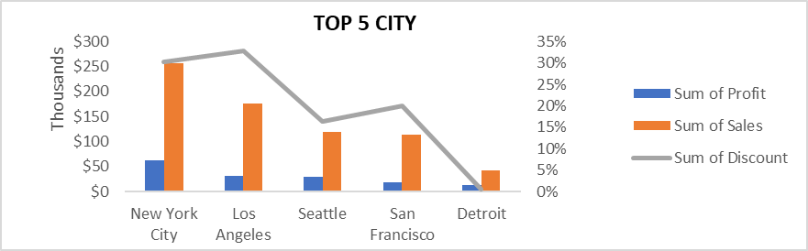
Here New York City gives all over higher profit and sales but Los Angeles gives higher discount given by all fields. After exploring the data, it shows-
Detroit engages higher profit, sales and discount in central region.
New York engages higher profit, sales in first class, second class ship mode, consumer segment and technology category as well as discount in east region and furniture and office supplies category and also for discount in same day and standard class ship mode.
Atlanta engages higher profit and sales in south region.
Los Angeles engages higher profit, sales and discount in west region as well as discount in first class and second class ship mode and corporate and home office segment and technology category.

Slide 11
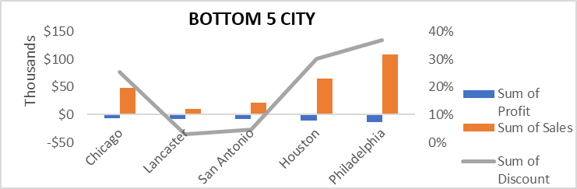
Now this figure states that Philadelphia shows highest negative profit but highest positive sum of sales and discount given by all field. After exploring the data, it shows-
Houston gives highest negative profit in first class ship mode and office supplies category but also highest positive sum of sales and discount in central region and higher discount in second class ship mode.
Philadelphia reflects highest negative profit but highest positive sum of sales and discount in east region and office supplies category as well as first class and standard class and for furniture category and highest negative profit and highest positive sum of sales in second class ship mode as well as consumer and corporate segment.
Burlington gives highest negative profit in same day ship mode but also Jacksonville shows highest positive sum of sales in home office segment and discount in south region.
Louisville gives highest negative profit but Phoenix shows highest positive sum of sales and discount in west region.

Slide 12
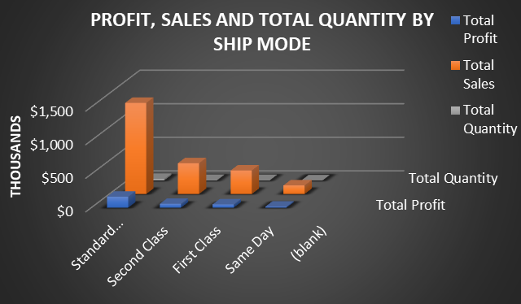
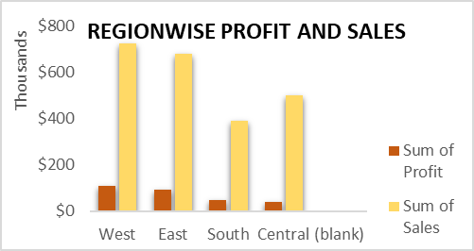
Now here standard class ship mode gives higher profit, sales and quantity sold given by all field. After exploring the data, it shows-
Standard class ship mode gives higher profit, sales and quantity sold in all regions and for all segments and also for all categories and opposite happens in same day ship mode in all regions and for all segments and also for all categories which gives lowest outcome.
From second figure, it states that west region has highest profit and sales also but south region has lowest profit as well as sales also. After exploring the data, it shows-
West region gives higher profit and sales for all ship modes, segments and categories. But south region always suffers losses even suffers negative profit also for one ship mode.

Slide 13
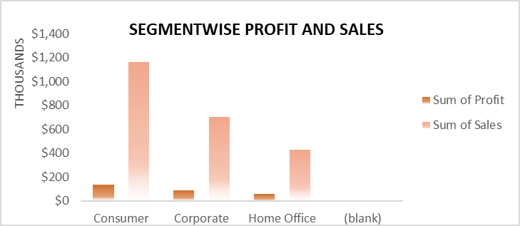
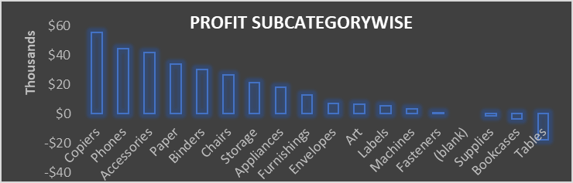
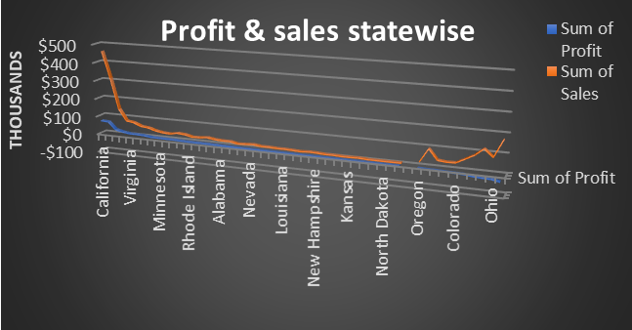
In the first case, consumer segment gives higher profit and sales but home office gives lower profit by all field.
In the second figure, copiers profit is high in the subcategory under technology category. But fasteners, suppliers, bookcases and tables are suffering average losses which has to be reviewed.
In the third figure, California, Virginia etc. reflects higher profit but Ohio, Colorado, Oregon etc. are having losses i.e. suffering negative profit.

Slide 14
OVERALL FINDINGS
Technology is earning highest profit whereas furniture is earning lowest profit in all cases.
California has higher profit and higher quantity sold given by all field.
Texas has highest negative profit and North Carolina has highest negative quantity sold given by all field.
New York City gives all over higher profit and sales but Los Angeles gives higher discount given by all fields.
Philadelphia shows highest negative profit but highest positive sum of sales and discount given by all field.
Standard class ship mode gives higher profit, sales and quantity sold given by all field and opposite happens in same day ship mode in all regions and for all segments and also for all categories which gives lowest outcome.
West region has highest profit and sales also but south region has lowest profit as well as sales also.
Consumer segment gives higher profit and sales but home office gives lower profit by all field.
Copiers profit is high in the subcategory under technology category. But fasteners, suppliers, bookcases and tables are suffering average losses which has to be reviewed.
Wyoming, Colorado, Oregon, Arizona, Ohio, Illinois etc. states are having losses i.e. suffering negative profit. Company needs to take steps on those states to extend sales and profit.

Slide 15
FINAL INSIGHTS OF THE BUSINESS PROBLEM
In case of states where profit is negative or state suffers average loss, in those areas sold product quality have to be reviewed because may be there are some reasons e.g. investors dissatisfaction about sold product quality or selling pattern.
In case of region, less quantity is selling into the investor which does not reveal actual speciality of the product of a particular region to them e.g. south region. So it has to be extended.
As well as in other fields like ship mode, segment and category, in all fields advertisement of the product should be needed for exploring.

Slide 16
THANK YOU

